Slide 1
Battery Range Indicator Circuit
Course: Linear Circuit Analysis
Semester: Fall 2025
- Yousef Alabkal 57078
- Essa Altaher 10086967
-Yousef AlAbdulrazzaq 75018

Slide 2
Introduction and problem definition
Systems that use batteries require a simple way to indicate charge
Users must know the charge level
Low
Normal
Overcharged
Incorrect battery usage may reduce the batteries life and damage devices
Essa Altaher

Slide 3
Project Context and Objectives
Context:
Used in portable Electronics
Fully analog solution (no micro controllers)
Objectives:
Monitor battery voltage
Compare voltage against thresholds
Display battery state using LEDs
Include ON/OFF control
Essa Altaher

Slide 4
Design Constraints and standards
Essa Altaher

Slide 5
Realistic Constraints
Limited components
Fixed supply voltage
Battery voltage range limitation
LED current safety limit
Output behavior
Cost and simplicity
Yousef Alabkal

Slide 6
Engineering standards
IEC 61010-1 - General electrical safety
IEC 62133 - Battery safety
IEC 60747 - Semiconductor components (LM393, BC547)
GSO 2530 - GCC low voltage requirements
IEEE 315 - Schematic symbols
ABET design and safety considerations
Yousef Alabkal

Slide 7
Literature Review
Battery indicators commonly use:
Voltage dividers
Comparators or op-amps
LM393 comparator is widely used due to its:
Low power consumption
Dual comparator configuration
Open collector outputs ***
Yousef Alabkal

Slide 8
Possible solutions
Comparator-based voltage monitoring
Simple LED threshold indicator
Micro-controller solution
Yousef Alabkal

Slide 9
Design Process
Scale battery voltage using a voltage divider.
Generate reference voltages using resistors.
Compare battery voltage with reference thresholds using comparators.
Control led based on comparator outputs.
Implement on/off control using a switch.
Yousef AlAbdulrazzaq

Slide 10
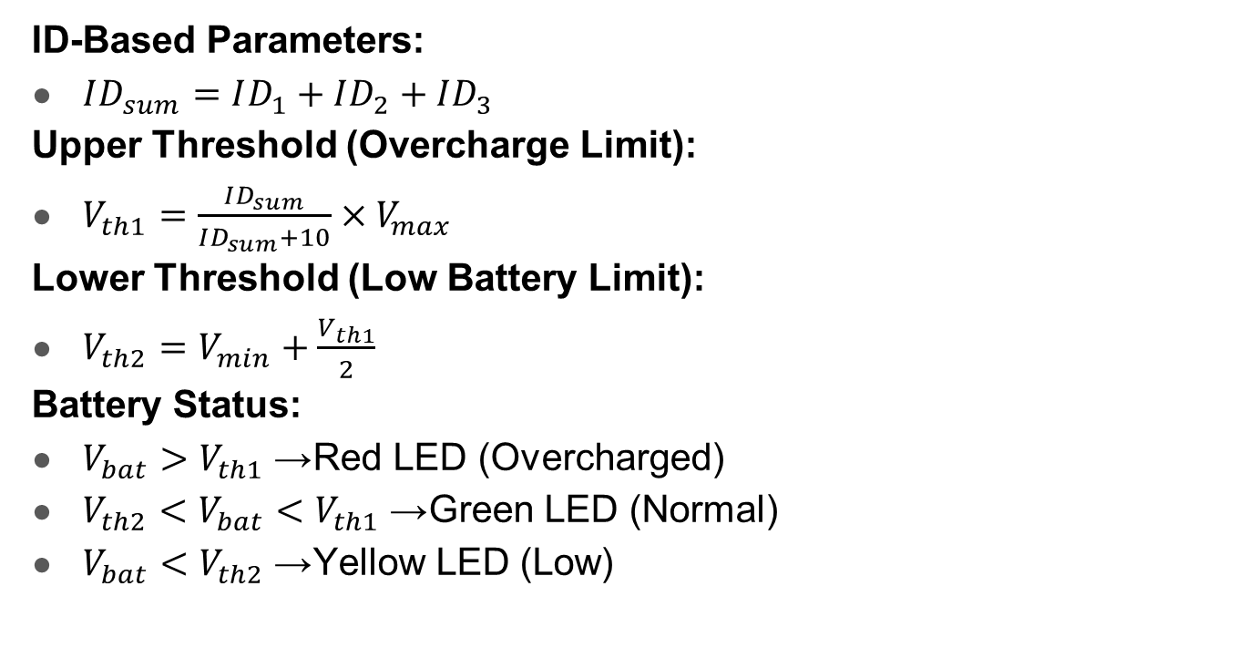
Threshold Calculations:
ID-Based Parameters:
$ID_{sum}=ID_{1}+ID_{2}+ID_{3}$
Upper Threshold (Overcharge Limit):
$V_{th1}=\frac{ID_{sum}}{ID_{sum}+10}×V_{max}$
Lower Threshold (Low Battery Limit):
$V_{th2}=V_{min}+\frac{V_{th1}}{2}$
Battery Status:
$V_{bat}>V_{th1}$→ Red LED (Overcharged)
$V_{th2}<V_{bat}<V_{th1}$→ Green LED (Normal)
$V_{bat}<V_{th2}$→ Yellow LED (Low)
Yousef AlAbdulrazzaq

Slide 11
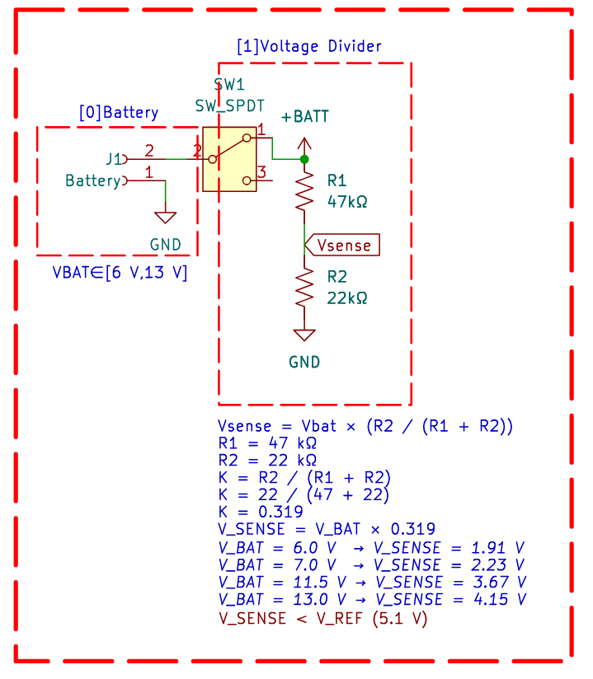
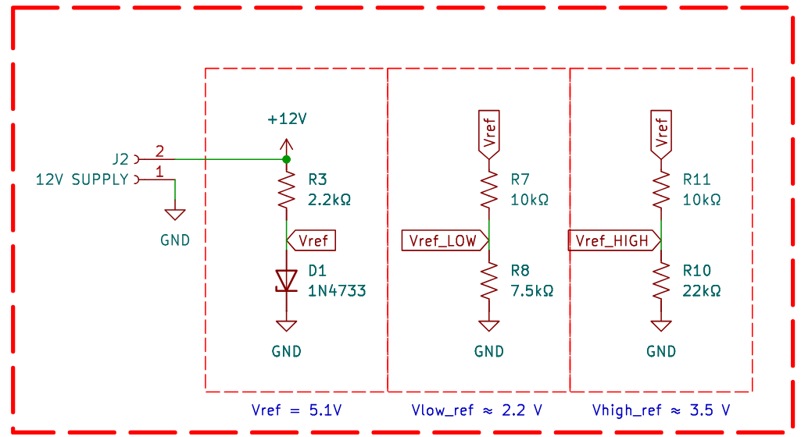
Circuit Design schematic
Yousef AlAbdulrazzaq

Slide 12
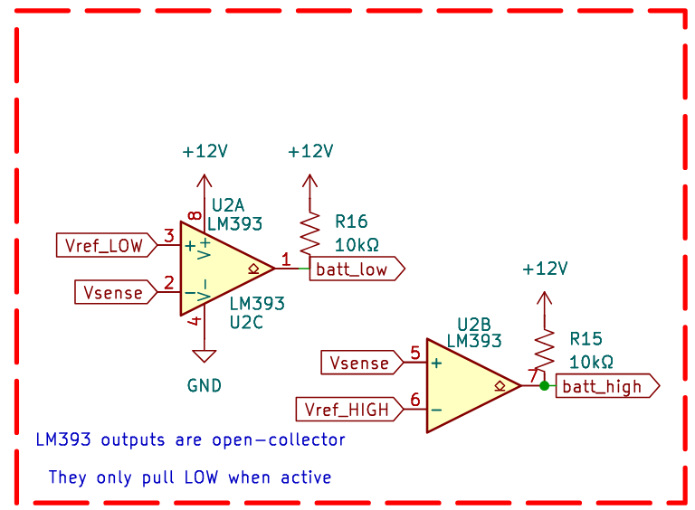
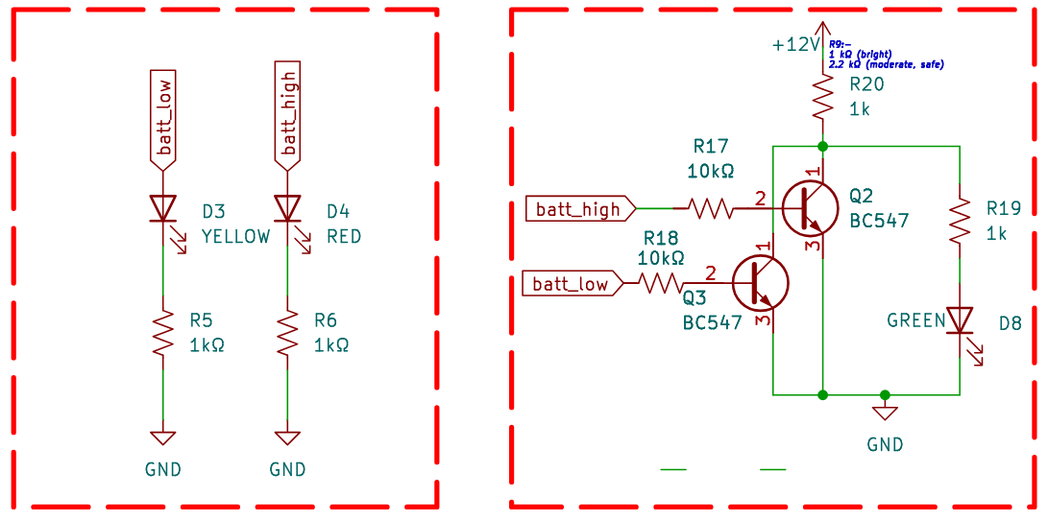
Circuit Design schematic
Yousef AlAbdulrazzaq

Slide 13
Circuit Operation
Normal Battery: Vth2​<Vbat​<Vth1
LM393 outputs do nothing.
So the base of Q1 sees:
+12 V -> R20 -> base:
Base is HIGH
Q1 turns ON
Green LED turns ON
Overcharged Battery: Vbat​>Vth1​
batt_low output pulls the base down through R17.
Result:
Base voltage drops near 0 V
Q1 turns OFF
Green LED turns OFF
Low Voltage Battery: Vbat​<Vth2​
Same idea:
batt_high pulls base LOW through R18
Q1 turns OFF
Green LED turns OFF
Yousef AlAbdulrazzaq

